Slide 1
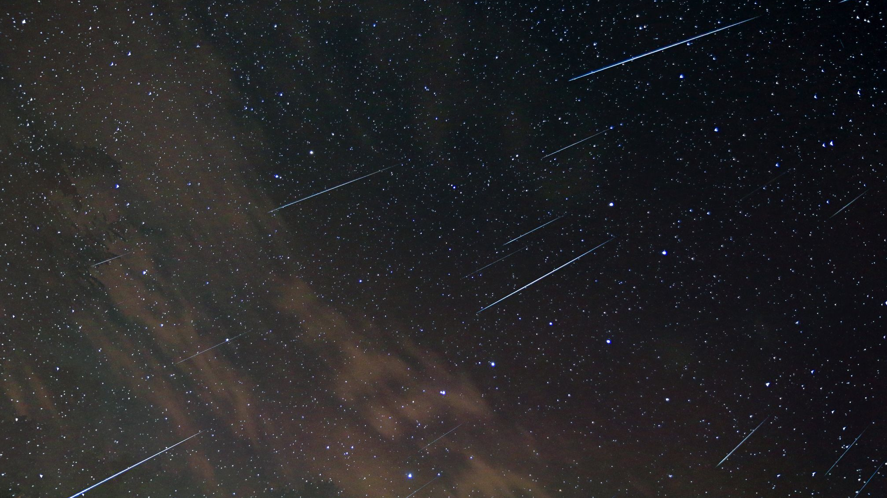
Search for Clusters in Meteor Orbit Databases
IMC 2024
Kutna Hora, The Czech Republic
Aishabibi Ashimbek
Jérémie Vaubaillon

Slide 2
Scientific context
2022 TAH Cluster (Vaubaillon et al., 2023)
Meteor cluster
No “official” definition
8 meteor clusters ever detected
Meteoroid self-fragmentation due to thermal stress (Čapek et al., 2022)
Aisha Ashimbek
Notes:
Meteor cluster is the occurrence of many meteors in a restricted portion of the sky within just a few seconds. This definition is rather conceptual, as no official definition has been established yet due to the fact that meteor clusters are a rarely observed phenomena, with only 8 cases reported so far.

Slide 3
Objective
Search in meteor orbit databases to determine if we can detect more meteor clusters
What is the frequency of meteoroid self-fragmentation?
How does it change the physical lifetime expectancy?
How old is what we observe?
Meteors → parent bodies → early Solar System
Aisha Ashimbek

Slide 4
Reported clusters
Author | Observation date | Associated shower | Parent body | Orbit type | # of fragments | 𝜟t [s]
Hapgood & Rothwell | 12-Aug-1977 | Perseids | 109P/Swift-Tuttle | HTC | 3 | 1.3
Piers & Hawkes | 18-Oct-1995 | – | (3D/Biela) | (JFC) | 5 | 0.5
Kinoshita et al. | 17-Nov-1997 | Leonids | 55P/Tempel-Tuttle | HTC | 100-150 | 2
Watanabe et al. | 18-Nov-2001 | Leonids | 55P/Tempel-Tuttle | HTC | >15 | 4
Watanabe et al. | 18-Nov-2001 | Leonids | 55P/Tempel-Tuttle | HTC | 38 | 2
Koten et al. | 9-Sep-2016 | ε-Perseids | unknown | LPC | 9 | 1.5
Vaubaillon et al. | 31-May-2022 | τ-Herculids | 73P/Schwassmann – Wachmann 3 | JFC | 38 | 11.3
Koten et al. | 30-Oct-2022 | – | – | (HTC) | >22 | 10
Aisha Ashimbek
Notes:
We know of 8 meteor clusters as of today and this table summarizes their important characteristics. Firstly, we can notice that 6 out of 8 clusters are associated with known meteor showers, and we observe that they mainly originate from comets which is reasonable since meteoroids that have a cometary origin tend to be fragile and porous and therefore, prone to self fragmentation. The parent bodies have varying orbit types despite the small size of the dataset. And this means that meteor clusters are not unique to a specific family of comets.

Slide 5
Method: Databases
International Astronomical Union Meteor Data Center (IAU MDC)
SonotaCo
20–30 stations across Japan (¼ continuous)
CAMS
Cameras for Allsky Meteor Surveillance
3 stations across Northern California, USA
Temporal extent: January 1, 2007 – December 31, 2022 (16 years)
Aisha Ashimbek
Notes:
The smallest bullet points don’t have to be mentioned here. I’m assuming people will be familiar with these databases

Slide 6
Method: Detection
Clustering algorithm - DBSCAN (scikit-learn)
Density-Based Spatial Clustering of Applications with Noise
Minimal requirements of domain knowledge
Clusters of arbitrary shapes and varying densities
Efficient for large datasets ( >> few thousand objects)
Applied to observable geocentric quantities of meteors:
t - observation time of the meteor [s]
v_{g} - geocentric velocity [km/s]
(𝛼_{g}, 𝛿_{g}) - equatorial coordinates of the geocentric radiant [°]
normalized to range [-1,1], except t to [-10⁵,10⁵]
Arguments: minPoints, 𝜀
Aisha Ashimbek
Notes:
For detecting meteor clusters, I used a clustering algorithm called DBSCAN in the machine learning library of Python called scikit-learn. It is a density based spatial clustering algorithm and it was chosen as it fulfills 3 requirements that are crucial when working with a large dataset. Firstly, it requires minimal knowledge of the domain in determining input parameters that are not always known in advance. Secondly, it has the ability to detect clusters of arbitrary shapes and varying densities. And lastly, it has a good efficiency for datasets containing significantly more than just a few thousand objects.
So the algorithm was then applied to the geocentric quantities of meteors that are directly linked with their observations, and they are the time of the observation of the meteor, their geocentric velocity, and equatorial coordinates of their geocentric radiant.
Lastly, DBSCAN requires two arguments to be initialized, and that’s minPoints which is the minimum number of points a cluster must contain, and the second is epsilon which is the distance criterion defined by the radius within which to search for neighboring data points.

Slide 7
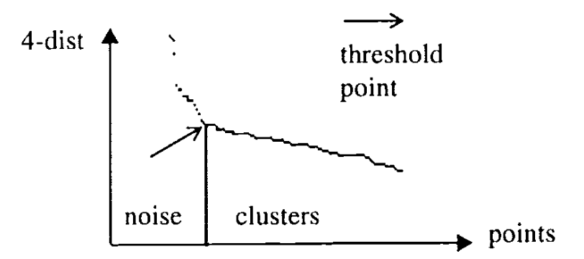
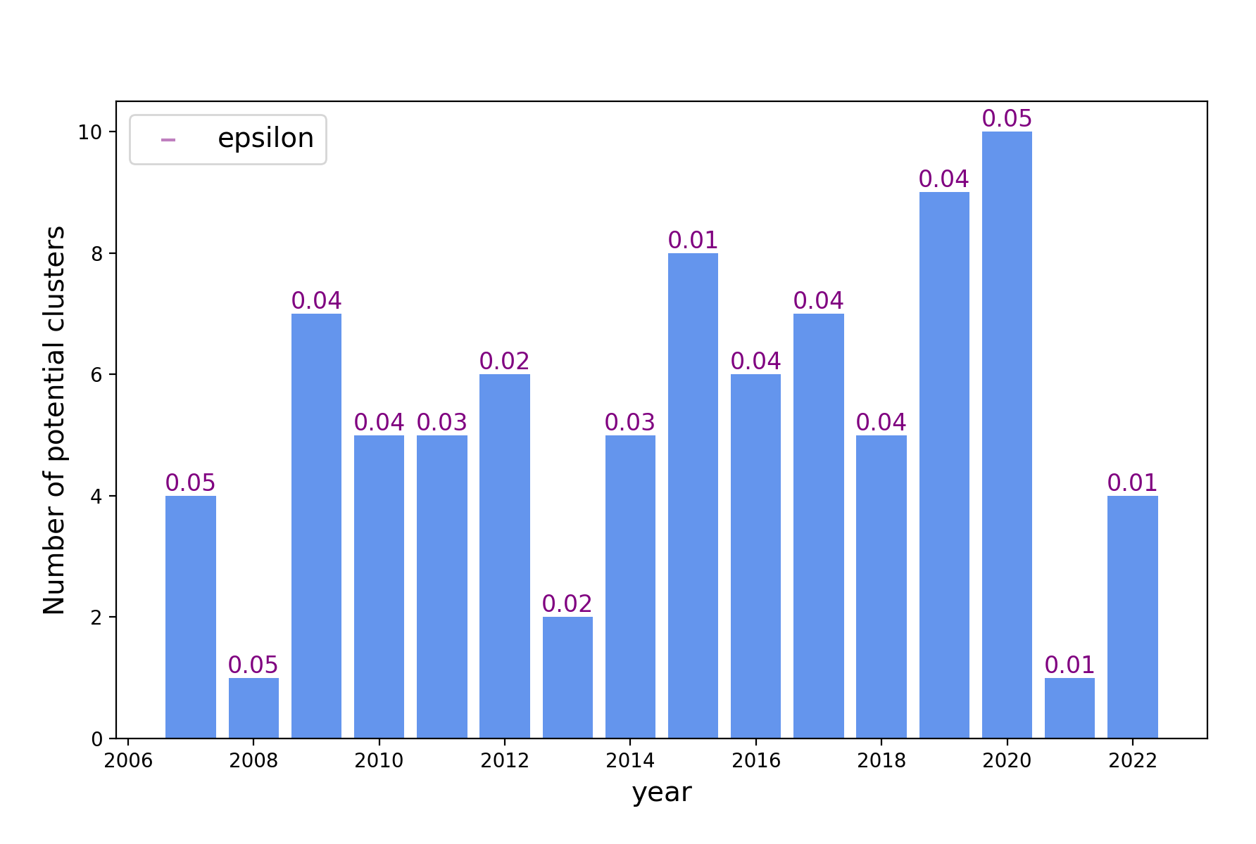
Distance criterion, 𝜀
Calculated using the Euclidean norm
Optimal value by Ester et al., 1996 - distance to the k^{th} nearest neighbor (k = MinPoints - 1)
→ not scientifically robust/meaningful for our dataset
Our method - growing epsilon
≤10 clusters per year
Aisha Ashimbek
Notes:
In order to choose the optimal distance criterion for clustering, the developers of DBSCAN propose a method to compute the distance to the kth nearest neighbor of each meteor, where k is minPoints-1. When plotted in descending order, the graph is supposed to provide clues on the density distribution of the data points. And from there, the first valley point is considered to be the optimal threshold with the points to the right being in a cluster, and points to the left being noise points. However, they do not necessarily provide any justification for this method. Nevertheless, we gave it a try and found that given the large size of our dataset and the rarity of clusters compared to unclustered meteors, the ratio of noise points to cluster points is too large, therefore it is not so practical to identify the valley point. Therefore, we found this method to be not scientifically robust enough or meaningful at least in our case. So having not determined an optimal method to choose one single epsilon for our dataset, we instead decided to experiment with different values of epsilon and prioritize analyzing the most promising clusters.
To do so, for every year we chose to stop at an epsilon value that yields 10 or less clusters. This method ensures that the output clusters are the ones with the closest possible points.

Slide 8
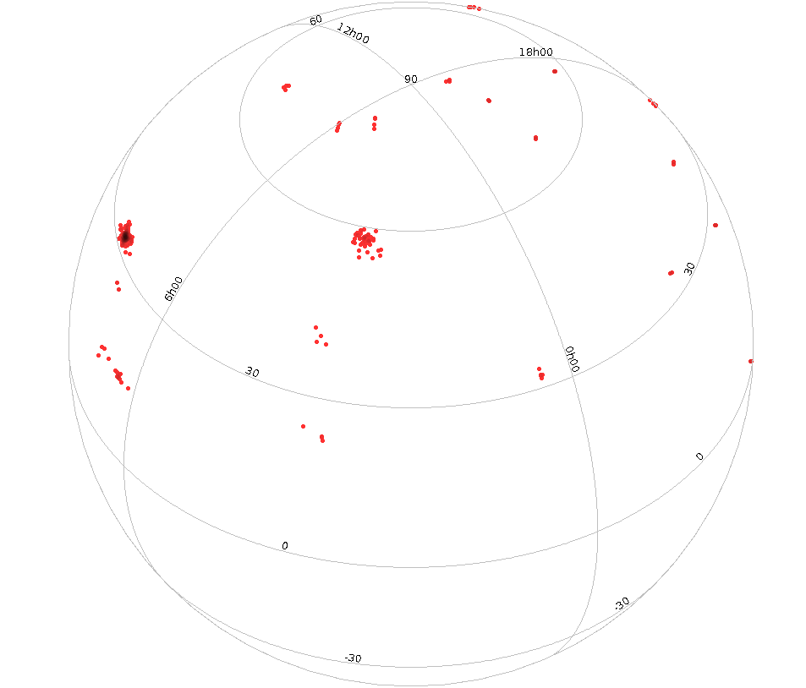
Cluster candidates
→ 85 meteor cluster candidates
4–7 fragments
Aisha Ashimbek
Notes:
This method resulted in 85 meteor cluster candidates within the span of 16 years.

Slide 9
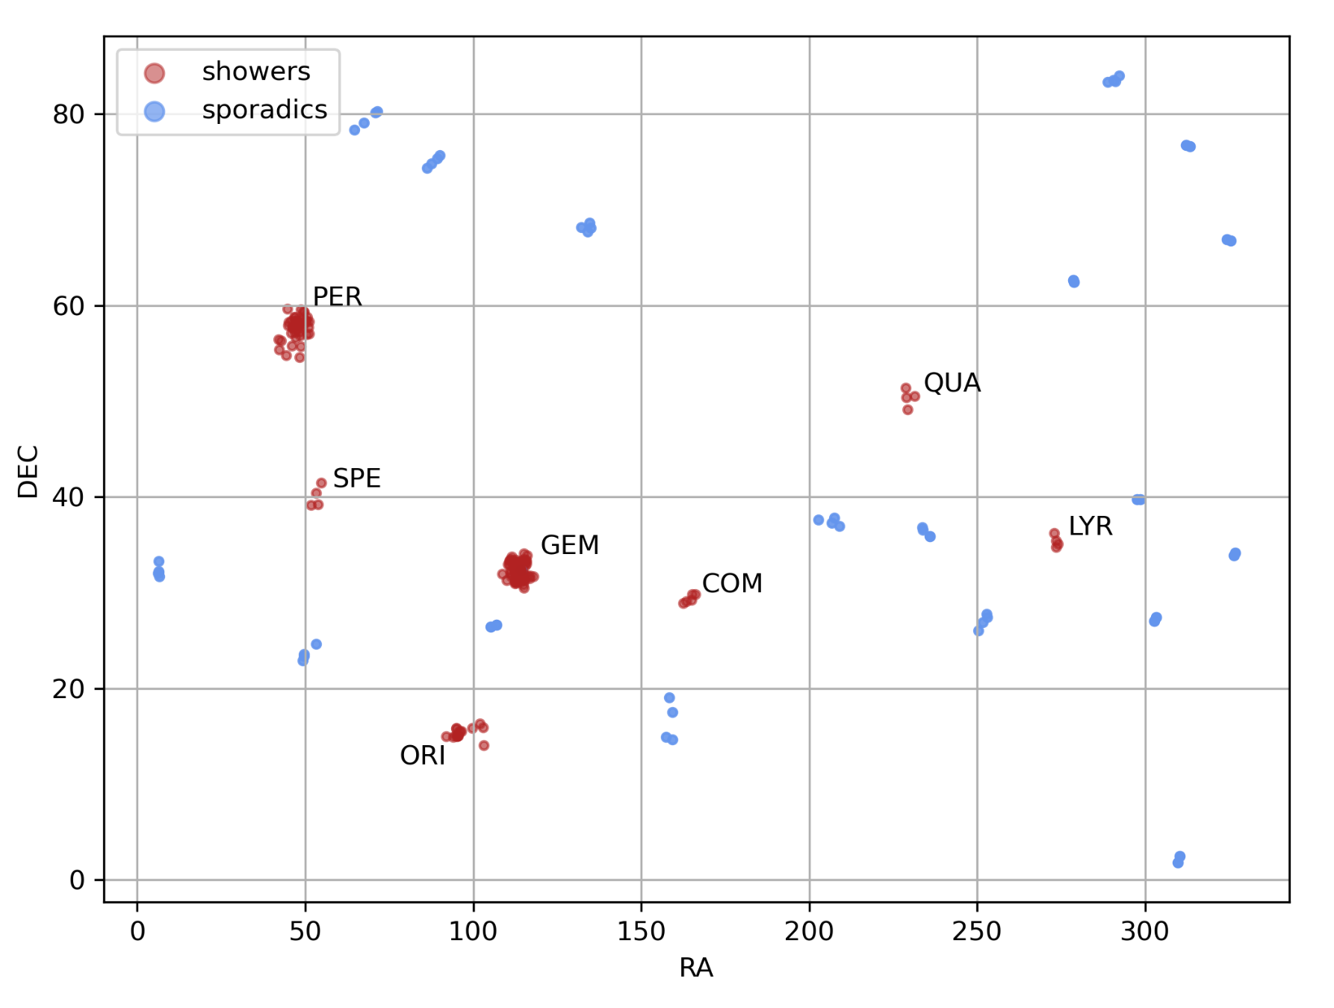
Shower association
Orbit similarity criterion D_{N} by Valsecchi et al., 1999 involving four geocentric quantities linked to observations: 𝜆 (solar longitude), v_{g} , 𝛼_{g} , 𝛿_{g}.
⇨ 67/85 cluster candidates associated with 7 known meteor showers
Aisha Ashimbek
Notes:
From there, we carried out a shower association test to determine which clusters are part of established meteor showers. In order to do so, we used the distance function DN defined by Valsecchi et al. to test the orbital similarity of meteoroid orbits with the shower orbits, based on their observed geocentric quantities. We found that 67 out of the 85 cluster candidates are associated with 7 known meteor showers with the majority in Geminids and Perseids.

Slide 10
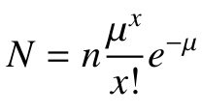
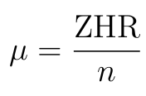
Statistical significance analysis
Number of expected clusters per hour:
Follows the Poisson distribution
n = number of intervals (in an hour)
𝜇 = mean rate of meteors per interval
x = number of meteors in the cluster
where
Poisson model underestimates N by a factor of 3 (Sampson 2007)
Meteor shower | GEM | PER | ORI | QUA | COM | LYR | SPE | Sporadic
ZHR_{max} [h⁻¹] | 150 | 110 | 20 | 80 | 3 | 18 | 8 | 11.6
Aisha Ashimbek
Notes:
Knowing the shower association of our clusters, the next step was to distinguish real clusters from random occurrences. Therefore, we did some statistical analysis where for a given cluster that we observed, with a given time separation and number of meteors within, how many of such clusters, N, would we expect to occur randomly, and N here follows a poisson distribution. This computation takes into account the duration of the cluster, number of fragments, and if a cluster is associated with a shower, then also the zenithal hourly rate of the shower. In case a cluster is not associated with a shower, we consider it part of the sporadic background of meteor showers and take the hourly rate of the sporadic background.

Slide 11
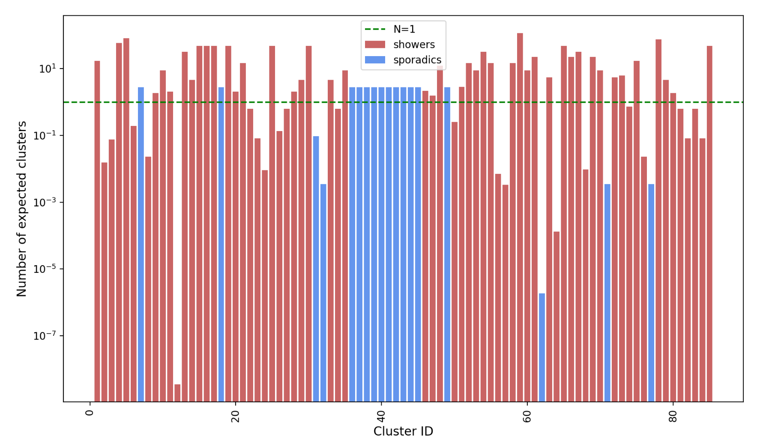
Statistical significance analysis
Number of expected clusters for the entire observation duration, N_{tot} :
Meteor shower: N * duration of a shower
Sporadic: N * total temporal extent of the dataset
Aisha Ashimbek
Notes:
The N value in the previous slide was for an hour of observation, but we need to take into account the total duration of the observation since they were continuous. So in the case of the clusters associated with showers, we take the known duration of the showers and multiply it by N, and for the sporadic background we take the time span of the entire dataset. And get N total values. In this graph we show the results, and the green dashed line is N=1 meaning 1 observed cluster. And for all the bars exceeding this line, we can say that these clusters could’ve easily occurred randomly because the number of expected clusters is more than 1. And for the bars that are way below this line, N total is practically zero but we observe a cluster there meaning that they could indeed be real. So we will now focus on these clusters with significantly low N total values. And this also validates the method of tuning epsilon to identify only 10 most promising clusters per year and not more because even among these, we dismiss the majority as chance occurrences.

Slide 12
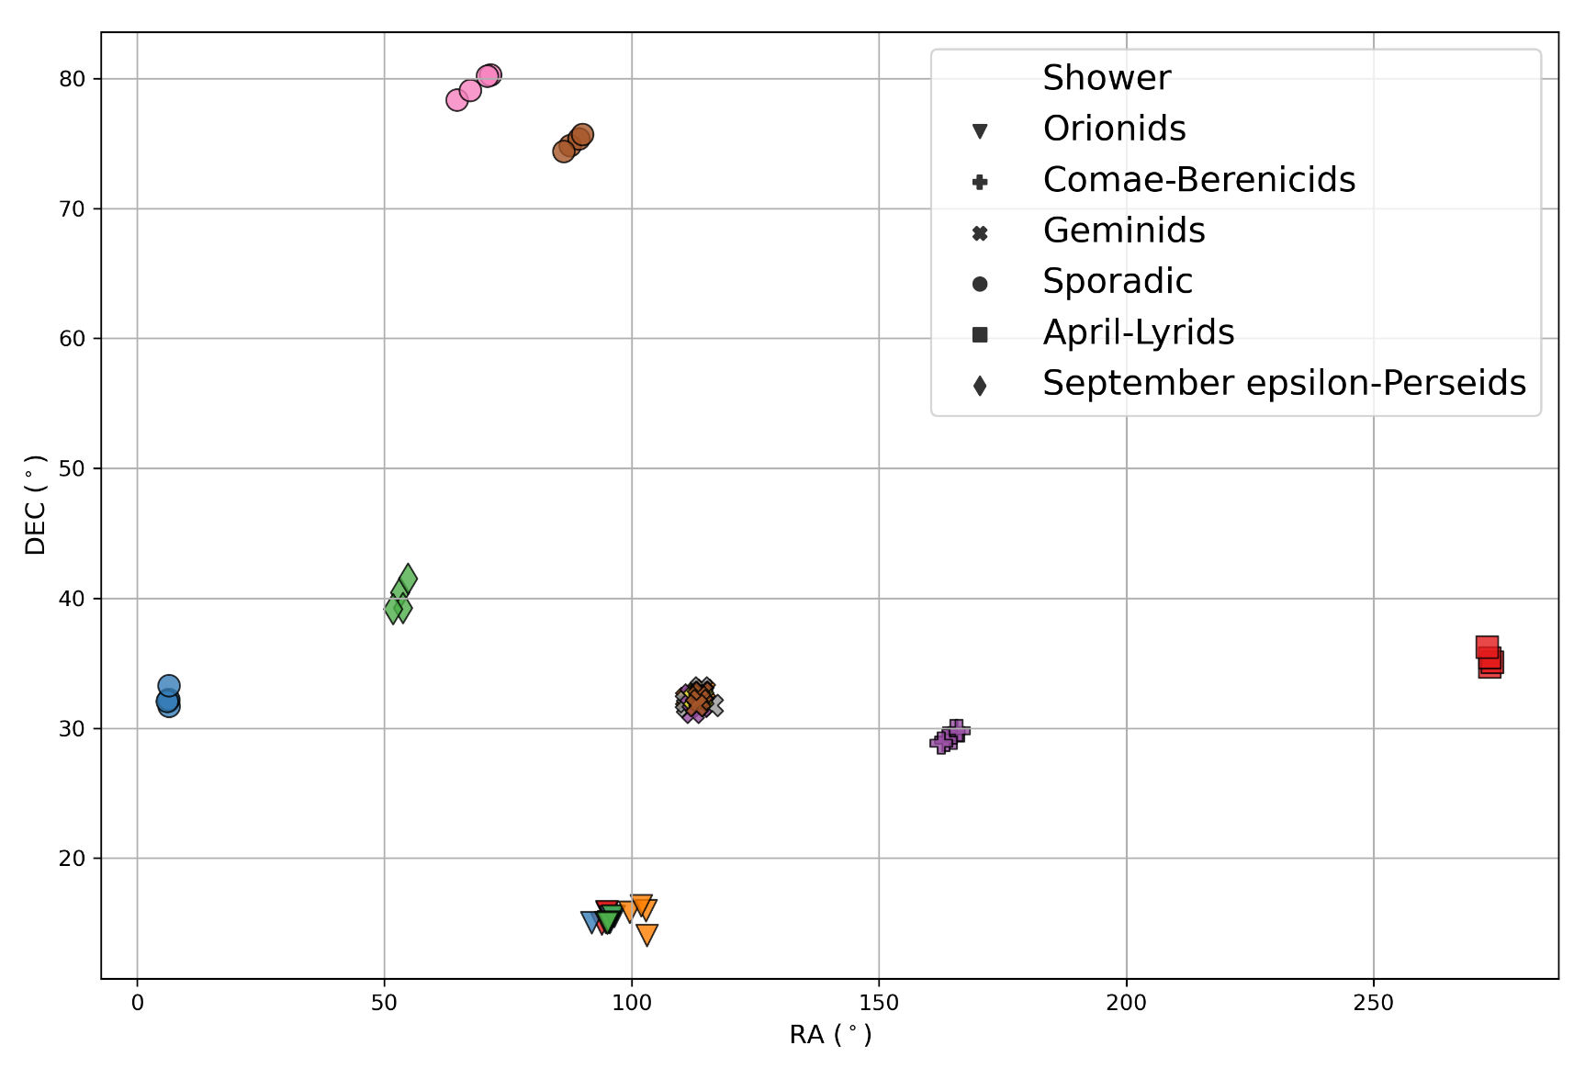
High-confidence clusters
Final result: 16 meteor clusters
6 in Geminids
4 in Orionids
1 in Comae Berenicids
1 in April Lyrids
1 in September-ε Perseids
3 from the sporadic background
Aisha Ashimbek
Notes:
As a result, we got 16 meteor clusters with sufficiently low n tot values to be real. We find one high-confidence cluster in the September perseids where one cluster was previously found by Pavel Koten.

Slide 13
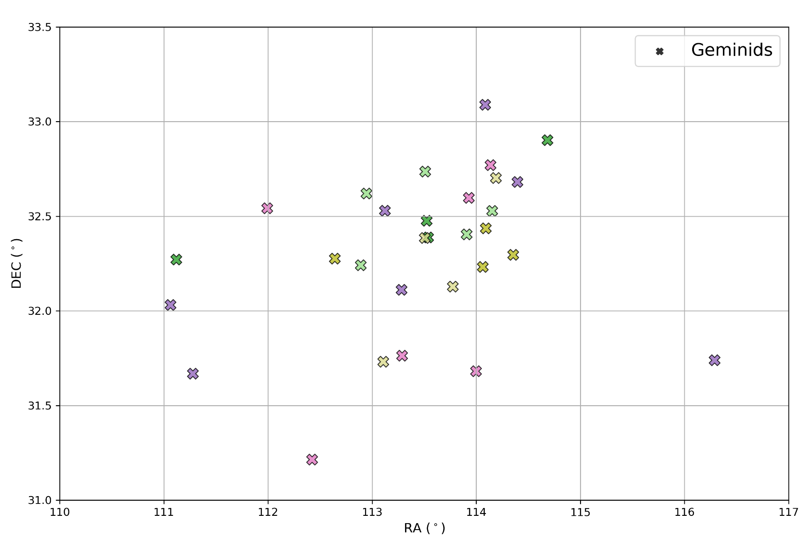
Geminids: 6 meteor clusters
Parent body - 3200 Phaethon - active asteroid
Aisha Ashimbek
Notes:
We’ve observed almost one third of our clusters in the Geminids which is a very interesting case because most confirmed clusters have a cometary origin but Geminids originate from an active asteroid called phaethon. Phaethon is a bit of a mystery because it's not well understood how an asteroid can produce such a plentiful meteor shower, so it raises a question if this is a special case for meteor clusters, or if asteroids in general can exhibit such behavior and produce clusters.

Slide 14
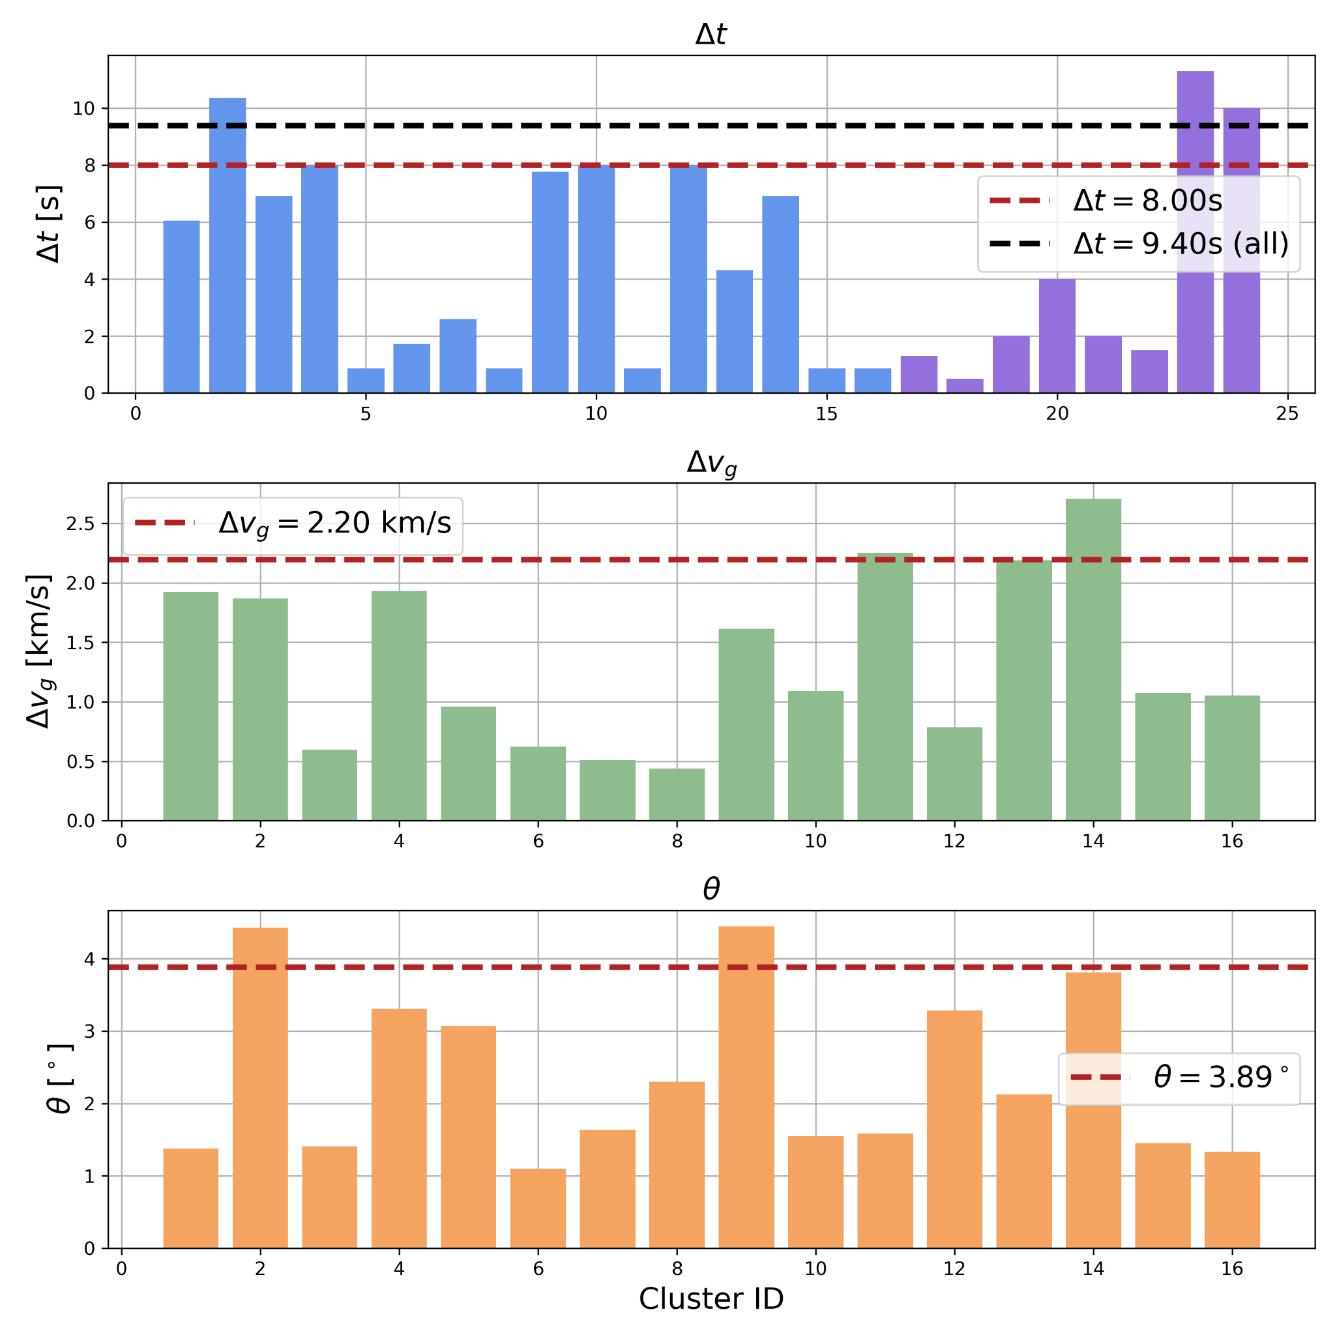
Towards a definition of a meteor cluster
----- 90th percentiles of cluster parameters
Aisha Ashimbek
Notes:
As mentioned before, there is no official definition of a meteor cluster yet with only 8 cases being reported, so with this study we are taking a step towards formulating a definition by identifying twice as many clusters. However, our intention is not to set strict limits on any parameters, in order not to introduce any bias in future studies, but to present some preliminary statistics of our set of data.
Since we don’t know the precise thresholds for the maximum possible time between meteors, or the velocity and angular separation required to be considered a cluster. So we took the 90th percentile to focus on the central tendency of the data and avoid potential outliers.

Slide 15
Towards a definition of a meteor cluster
4–7 fragments per cluster
Meteor cluster may not be as rare as only eight, but they may also not typically be as abundant as the majority of confirmed clusters → observational bias?
Aisha Ashimbek
Notes:
As for the number of fragments per cluster, we see that it ranges from 4 to 7 (animated when slideshow).

Slide 16
Conclusion
Detection algorithm resulted in 85 cluster candidates.
16 clusters have sufficiently low N_{tot} values to be considered real clusters.
13 meteor clusters from 5 meteor showers and 3 from the sporadic background.
6 meteor clusters in Geminids whose parent body is an active asteroid.
Preliminary statistics of 16 meteor clusters,
90th%: 𝛥t < 8s, 𝛥v_{g} < 2.20 km/s, 𝜃 < 3.89°.
Reported clusters could be detected due to their exceptionally intense outbursts.
Aisha Ashimbek

Slide 17
Future work
Add more databases: GMN, Allsky7 (?) etc.
Reassess the frequency of meteoroid self-fragmentation and its implication for the physical lifetime expectancy of meteoroids.
Current models represent only the collisions lifetime.
Article: under preparation
Workshop: with colleagues from the Czech Republic and Slovakia (November 2024)
Aisha Ashimbek

Slide 18
Thank you!

Slide 19
Extra slides

Slide 20
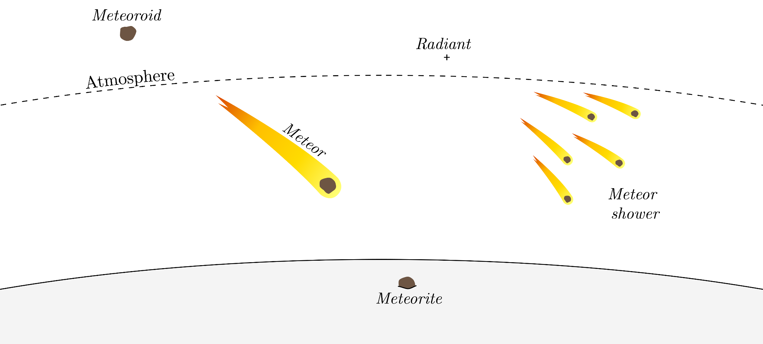
A few definitions…
(few hours - few weeks)

Slide 21
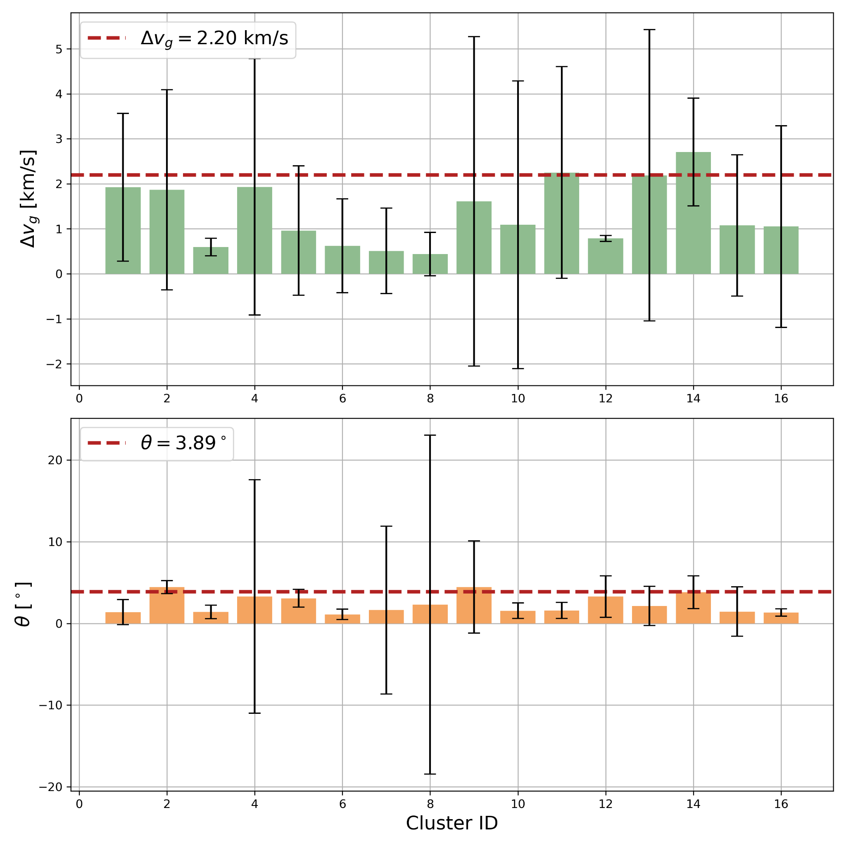
Accuracy of the data

Slide 22
Cluster example (2017-12-13)
Associated shower: Geminids
Time difference: 7.78 s
V_{g} difference: 1.61 km/s
Angular separation: 1.86 deg
Meteor # | RA [°] | DEC [°] | v_{g} [km/s] | t
1 | 111.279 | 31.668 | 33.31 | 18:08:38.400000000
2 | 113.289 | 32.111 | 33.546 | 18:08:41.856000000
3 | 114.086 | 33.089 | 34.922 | 18:08:41.856000000
4 | 113.123 | 32.529 | 33.501 | 18:08:42.720000000
5 | 111.064 | 32.031 | 33.37 | 18:08:43.583999999
6 | 116.289 | 31.739 | 33.77 | 18:08:43.583999999
7 | 114.396 | 32.681 | 34.17 | 18:08:46.176000000

Slide 23
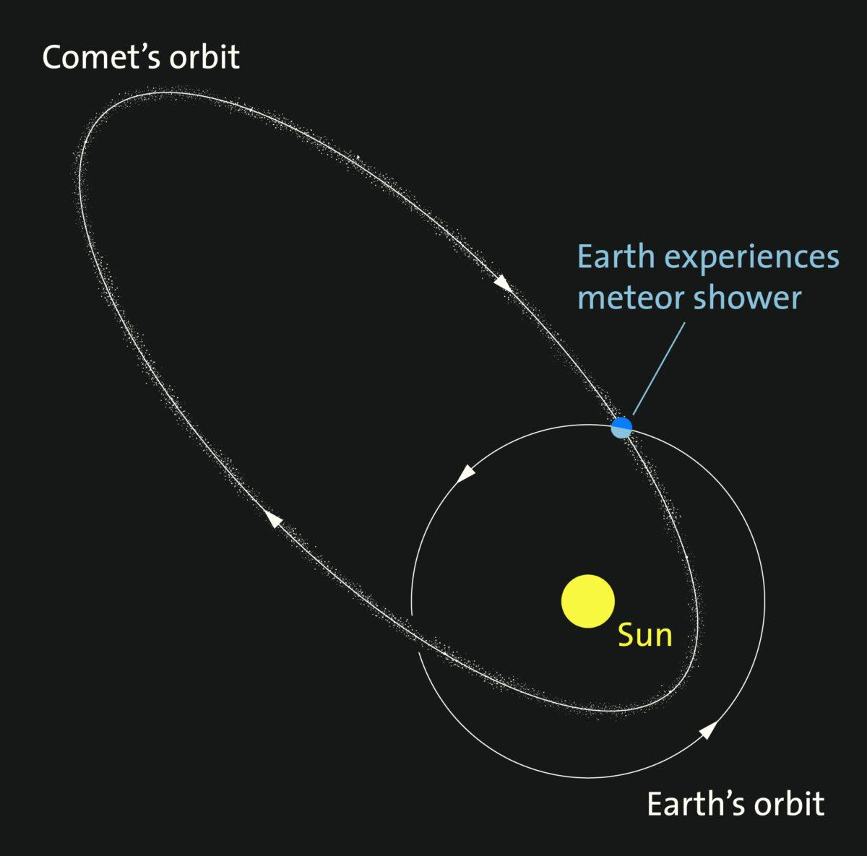
Meteoroid stream to meteor shower
Credit: Griffith Observatory

Slide 24
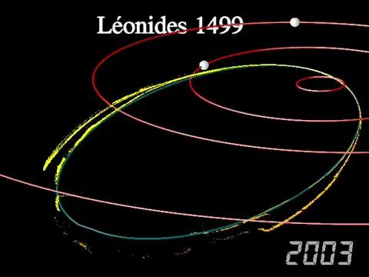
Prediction of meteor shower (Leonids)
Credit: J.Vaubaillon

Slide 25
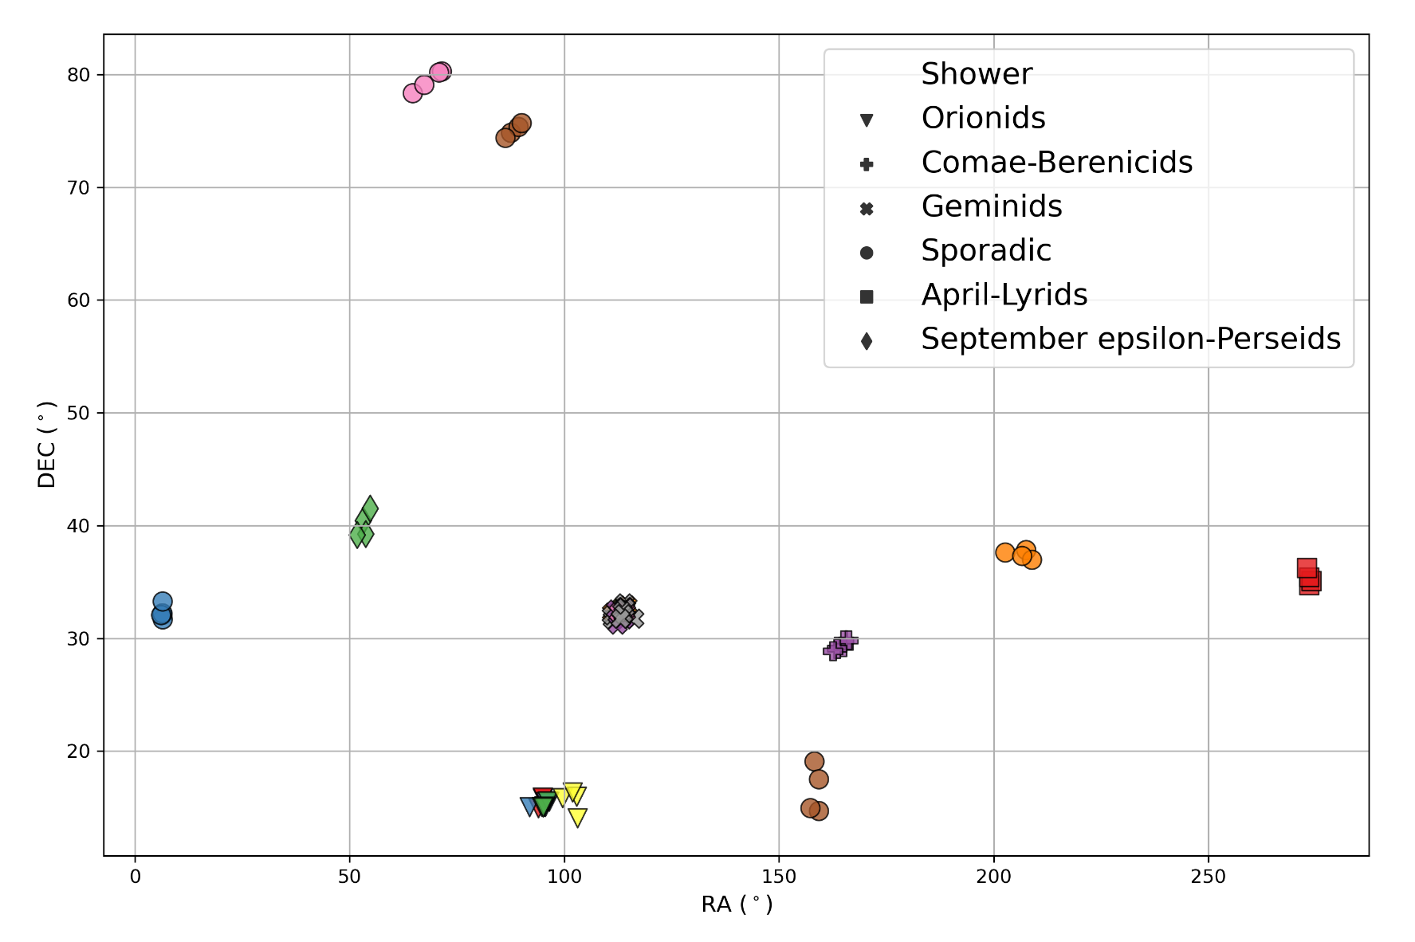
High-confidence clusters
18 meteor clusters with sufficiently low N_{tot}
Final result: 16 meteor clusters
6 in Geminids
4 in Orionids
1 in Comae Berenicids
1 in April Lyrids
1 in September-ε Perseids
3 from the sporadic background
Δv_{g} = 9.7 km/s
Δv_{g} = 7.9 km/s
Notes:
Add delta v for circled clusters

